Slide 1


Trading Signals Exploratory
Business Advisors: Manish Gupta, Xi Zhao
Faculty Advisor: Professor Peter Wysocki
Team 14 Members: Ziqi Shan, Man Shi, Kangjing Shi, Tzuhua(Agnes) Huang

Slide 2





Our Team
Kangjing Shi
Ziqi Shan
Man Shi
Agnes Huang
Notes:
Here are our team members, we have …….

Slide 3


Agenda
Introduction
Hypotheses
Methods & Models
Overview of process
Key findings
Details
Conclusion
Notes:
Then, we have some hypotheses to help you better understand before we start to introduce our two types of models. And, next, we will explain the process, with key findings, details and conclusion.

Slide 4
Introduction
Predict portfolios' appreciation or depreciation and identify ‘tradable signals’ in financial markets for the investors.
Dataset
3 Fund Types
Weekly data spans 10 years from 2006 through end-Jan 2017
Institutional mutual fund, ETF, retail mutual fund.
20 Asset Classes
4 Features
20 sectors in each market, including technology, healthcare, financials etc.
Funds-flow data including Flow, FlowPct, AssetsEnd, PortfolioChangePct
Notes:
The objective of the project is to find a tradable signal in financial markets. The mutual funds rotated cross different markets, investors want to know where and when to buy or sell the unit of mutual funds.
The dataset contains the weekly data spans 10 years from 2006 through end-Jan 2017.
There are 3 types of dataset which include
1. Institutional Mutual Fund Holdings (investments made/redeemed by institutional investors like Fidelity, Vanguard, Wells Fargo
2. Retail Mutual Fund Holdings (investments made by individuals in their portfolios)
3. ETF (Exchange Traded Funds - institutional investors)
We exclude the Retail Mutual Fund from our next analysis
Since the movements of retail MF follows the Institutional mutual fund and ETF, we only focus on the data from the later two markets(Institutional MF and ETF).
Each dataset contain 20 different asset classes which are a combination of stocks from the market. And, they all have four features
Funds-flow data including how much cash flow in and out in the week?,
FlowPct, the percentage of cash flow from last week to this week
AssetsEnd, represents the market value at that day
PortfolioChangePct means the percentage of difference in assetend from last week to this week

Slide 5
Hypothesis
#1
%Portfolio Change could be a predictive outcome for trading signals.
#2
Prediction for each sector may be captured by different methods/models.
#3
Explanatory and response variables of ETF and institutional mutual fund are interdependent.
#4
Advanced models are expected to enhance model predictability.
Notes:
Portfolio change represents the percentage of change in Assetend of this week minus assetend in the last week and removs the flow in this week divided by the assetend in the last week.
Ideally, we would expect that there is one model that could perfectly predict in each sectors. However, it’s hard to achieve in the real world practice. So we assume that 第二点…….

Slide 6
Methods & Models
#1 VAR (Vector Autoregression) Model
Capture the relationship between multiple time series variables.
Comprise one equation per response variable in the system.
#2 Long Short-Term Memory (LSTM) Networks
Store previous information and use it for processing the current input.
Able to learn long-term order dependencies.
Notes:
We build two different kinds of models in total.
First is vector autoregression model, it’s actually a type of stochastic process model, and it can capture the relationship between multiple quantities as they change over time.
Second is a more complex method called long short term memory networks. It’s an artificial recurrent neural network. This model is able to learn long-term dependencies between time steps of sequence data. In a simple word, LSTM can remember the long term previous information and use it for processing the current input.

Slide 7
Overview of Process
VAR Model 1
VAR Model 2
VAR Model 3
LSTM
Cross-market without MA(4)
Cross-market with MA(4)
Cross-market with MA(4) & market indices variable
Cross-market with MA(4) variable
Evaluate Model
Predictability
Return(t) - Return(t-1) > 0.1
1: Increase in portfolio return
Return(t) - Return(t-1) < - 0.1
-1: Decrease in portfolio return
-0.1 ≤ Return(t) - Return(t-1) ≤ 0.1
0: Unchanged
Notes:
Here is the overview of our process. First, we generate a cross market var model without applying moving average. Then we add the moving average smoothing method at windows equal to 4. Furthermore, we would like to see if market indices variable could influence for our prediction. And last, the LSTM model were build.
The method that we evaluate predictions is to change both actual value and predicted value to be a binary number which indicates direction. For example, if the the current value - previous value is greater than 0.1, we assign the value to be 1 and assume there is an increase in portfolio’s return. If it’s less than -0.1, then we put -1 instead, indicating a decrease trend. Otherwise, the value is 0, means return value is unchanged.
Next Agnes will talk more about our findings and performances across different models.

Slide 8




Key Findings
Converting actual values into classification labels helps identify tradable signals.
Applying moving average removes volatility and increases prediction accuracy.
01
02
Adding market index variables improves model predictability.
Compared to LSTM, VAR models demonstrate desirable prediction in several sectors.
03
04
Notes:
Next, we have some key findings as follows.
Since we have to identify directional patter, if we convert actual and predicted values into classification labels, that would help interpret tradable signals.
Since we use fund-flow data from the financial market, we have to consider volatility. We found that applying the moving average method removes volatility will increase prediction accuracy.
Adding market index variables improves model predictability.
Compared to the advanced model, LSTM, VAR models demonstrate desirable predictions in several sectors with an accuracy score up to 0.9.

Slide 9
More Details
■ VAR M1: Cross-market | ■ VAR M2: Cross-market MA(4)
■ VAR M3: Cross-market MA(4) & market index | ■ LSTM Network
 |  | Consumer Goods | Commo- dities | Energy | Finance | Health/ Biotech | Industrials | Large Cap Blend | Large Cap Growth | Large Cap Value
VAR M1 | P_e | 0.6 | 0.4 | 0.7 | 0.4 | 0.7 | 0.5 | 0.6 | 0.3 | 0.5
 | P_i | 0.2 | 0.7 | 0.8 | 0.5 | 0.5 | 0.5 | 0.7 | 0.5 | 0.5
VAR M2 | P_e | 0.3 | 0.6 | 0.6 | 0.4 | 0.9 | 0.5 | 0.5 | 0.6 | 0.4
 | P_i | 0.2 | 0.4 | 0.5 | 0.7 | 0.4 | 0.6 | 0.3 | 0.4 | 0.4
VAR M3 | P_e | 0.4 | 0.3 | 0.6 | 0.3 | 0.8 | 0.7 | 0.6 | 0.6 | 0.4
 | P_i | 0.5 | 0.4 | 0.3 | 0.6 | 0.5 | 0.6 | 0.5 | 0.6 | 0.4
LSTM | P_e | 0.5 | 0.4 | 0.6 | 0.7 | 0.6 | 0.6 | 0.5 | 0.6 | 0.4
 | P_i | 0.5 | 0.4 | 0.6 | 0.7 | 0.7 | 0.6 | 0.6 | 0.5 | 0.5
P_e: %Portofolio Change in ETF P_i: %Portofolio Change in Institutional Mutual Fund
Notes:
Here, we conclude our results in this table. Different colors represent different models we applied.
Since we got actual and forecast values, we calculate the accuracy score to evaluate our prediction results. The marked cells, the cell filled with colors, represent the sectors and their corresponding portfolio change percentage having higher accuracy scores, which means better performance.

Slide 10
More Details
■ VAR M1: Cross-market | ■ VAR M2: Cross-market MA(4)
■ VAR M3: Cross-market MA(4) & market index | ■ LSTM Network
 |  | Consumer Goods | Commo- dities | Energy | Finance | Health/ Biotech | Industrials | Large Cap Blend | Large Cap Growth | Large Cap Value
VAR M1 | P_e | 0.6 | 0.4 | 0.7 | 0.4 | 0.7 | 0.5 | 0.6 | 0.3 | 0.5
 | P_i | 0.2 | 0.7 | 0.8 | 0.5 | 0.5 | 0.5 | 0.7 | 0.5 | 0.5
VAR M2 | P_e | 0.3 | 0.6 | 0.6 | 0.4 | 0.9 | 0.5 | 0.5 | 0.6 | 0.4
 | P_i | 0.2 | 0.4 | 0.5 | 0.7 | 0.4 | 0.6 | 0.3 | 0.4 | 0.4
VAR M3 | P_e | 0.4 | 0.3 | 0.6 | 0.3 | 0.8 | 0.7 | 0.6 | 0.6 | 0.4
 | P_i | 0.5 | 0.4 | 0.3 | 0.6 | 0.5 | 0.6 | 0.5 | 0.6 | 0.4
LSTM | P_e | 0.5 | 0.4 | 0.6 | 0.7 | 0.6 | 0.6 | 0.5 | 0.6 | 0.4
 | P_i | 0.5 | 0.4 | 0.6 | 0.7 | 0.7 | 0.6 | 0.6 | 0.5 | 0.5
P_e: %Portofolio Change in ETF P_i: %Portofolio Change in Institutional Mutual Fund
Notes:
For example, we can take a look at the health and biotech sector. There are four highlighted accuracy scores in the cell, indicating we have a desirable prediction in the three models.
First, the cell filled with sky blue means the accuracy score of the first model, we got 0.7.
We keep adjusting all the models to see if there is an improvement in prediction. Next, in the blue cell, after we smooth the time series, we got a better prediction. If we look at the navy cell, after we added market indices to our data, the adjustment didn't necessarily improve the prediction, but it still has good performance.
The last two rows represent the advanced model, LSTM we applied. We can see that the advanced model may give us better prediction, but similarly, the more advanced model didn't necessarily improve the prediction.

Slide 11
More Details (cont.)
■ VAR M1: Cross-market | ■ VAR M2: Cross-market MA(4)
■ VAR M3: Cross-market MA(4) & market index | ■ LSTM Network
 |  | Mid Cap Blend | Mid Cap Growth | Mid Cap Value | Real Estate | Small Cap Blend | Small Cap Growth | Small Cap Value | Techno- logy | Telecom | Utility
VAR M1 | P_e | 0.4 | 0.6 | 0.5 | 0.8 | 0.4 | 0.6 | 0.4 | 0.6 | 0.6 | 0.5
 | P_i | 0.3 | 0.3 | 0.3 | 0.3 | 0.5 | 0.2 | 0.4 | 0.5 | 0.7 | 0.5
VAR M2 | P_e | 0.7 | 0.5 | 0.6 | 0.4 | 0.5 | 0.5 | 0.7 | 0.2 | 0.4 | 0.5
 | P_i | 0.5 | 0.3 | 0.5 | 0.3 | 0.6 | 0.5 | 0.4 | 0.3 | 0.3 | 0.6
VAR M3 | P_e | 0.4 | 0.4 | 0.8 | 0.4 | 0.7 | 0.6 | 0.7 | 0.4 | 0.4 | 0.4
 | P_i | 0.6 | 0.3 | 0.5 | 0.3 | 0.7 | 0.5 | 0.4 | 0.2 | 0.3 | 0.6
LSTM | P_e | 0.5 | 0.4 | 0.7 | 0.4 | 0.5 | 0.6 | 0.5 | 0.5 | 0.5 | 0.6
 | P_i | 0.6 | 0.6 | 0.6 | 0.5 | 0.5 | 0.6 | 0.6 | 0.5 | 0.5 | 0.6
P_e: %Portofolio Change in ETF P_i: %Portofolio Change in Institutional Mutual Fund
Notes:
Next, we can look at Small Cap Blend. We can look at the VAR model's prediction, as we tried more advanced VAR models, we would get more desirable predictions. But for this sector, LSTM didn't necessarily give us higher accuracy scores.

Slide 12
Key Results
#1
■ Simple model (VAR) may perform better than the advanced one (LSTM).
■ Predictions with VAR perform well in several sectors’ portfolio changes.
#2
■ The three VAR models show different performance on different sectors (higher accuracy: 0.8/0.9, lower accuracy: 0.2/0.3)
#3
■ LSTMs demonstrate balanced accuracy across all the sectors (accuracy rate: 0.4-0.7).
Notes:
By comparing the predictive results of VAR models and LSTM model, we found that the simple model performs better than the complex one since there are more sectors suitable for being predicted with VAR models rather than LSTM, which means they have higher accuracy scores with VAR models.
On the other hand, the performance of VAR models are excellent in several sectors which achieved an accuracy rate up to 80% or 90%, but VAR models also perform poorly in some other sectors (like only got the .2 and .3 accuracy rate in the Technology). However, the lstm model is actually more evenly predictive for all the sectors, it got the balanced accuracy rates from 40 to 70%.

Slide 13
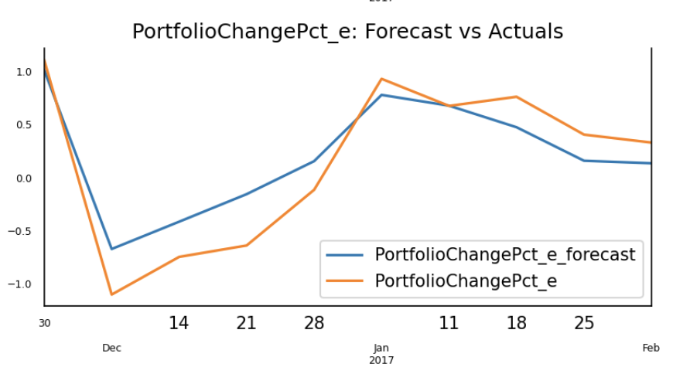
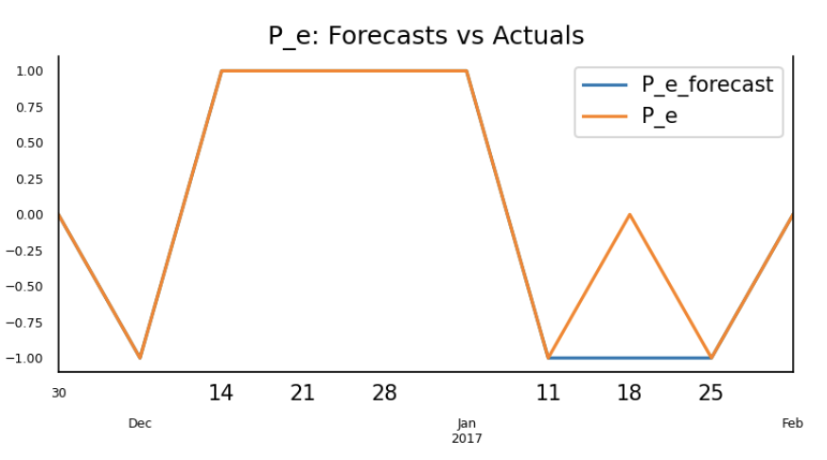
Identify Tradable Signal
Model 2: Cross-market MA(4) - Health/Biotech
%Portfolio Change in ETF
%Portfolio Change in ETF - Direction
— Actual
— Forecast
— Actual
— Forecast
Notes:
Here we take one of the best performing models as an example to explain the tradable signal. The plot on the left side shows the actuals versus forecasts of portfoliochange pct of Health/Biotech sector in ETF, which was predicted by VAR model with moving average method.
From the directional plot on the right side, we can see that some of the actual and predicted values overlap. As mentioned before, we classify the predictions into three classes: 1 (increase in portfolio change), -1 (decrease in portfolio change), and 0 (non-change). In this case, if the model generates a desirable accuracy score, there will be highly overlap in the directional plot. For example, when we choose a specific timestamp with both actual and forecast located in the class labeled -1, we can infer that the model successfully predict the negative movement of portfolio change before that week, and view it as a signal to invest in the sector because the following week’s values continuously increasing. Therefore, the investors could buy the Health/Biotech fund on Dec 7th. According to the model’s accuracy score 0.9, we would say approximately 90% of the portfolio’s movements are captured by the model.
That’s the way of how we identify the tradable signal in both institutional mutual funds and ETF market through the predictive models we constructed.

Slide 14
Thanks!
Any questions?

Slide 15
Sector Rotation (Funds)
Health
Industries
Consumer goods
Real Estate
Finance
2006
2017
Telecom
Technology
Commodities
Energy
Utilities

Slide 16
Introduction
Purpose
Find the tradable signals for the investors to decide whether to buy or sell
Dataset
Weekly data spans 10 year from 2006 through end-Jan 2017
3 types of funds: Institutional mutual fund, ETF, retail mutual fund
20 sectors in each market
Close price percentage change of Russell 2000, SP 500, Dow Jones, and Nasdaq
6 columns ( 4 features)
ReportDate, AssetClass, Flow, FlowPct, AssetsEnd, PortfolioChangePct, ClosePct

Slide 17
Appendix
5 features
Flow: amount of inflow and outflow in Millions of USD
FlowPct: flow as percent of assets at beginning of the week
AssetsEnd: assets at end of the week in Millions of USD
PortfolioChangePct: percent change in overall portfolio during the week
ClosePct: percentage change in close price of 4 US major indices
20 asset classes
Consumer Goods, Energy, Financials, Health Care, Industrials, Technology, Telecom and Utilities Industries
Combinations of large, mid and small companies in different phases like value, growth and blend .

Slide 18
Appendix
VAR model (vector autoregressive model):
A statistical model used to capture the relationship between multiple quantities as they change over time. VAR is a type of stochastic process model. VAR models generalize the single-variable (univariate) autoregressive model by allowing for multivariate time series.
Cross-markets:
P(ETF, k, t) = a + b1*F(ETF, k, t-1) + b2*F(instit, k, t-1) + b3*P(instit, k, t-1) + b4*P(ETF, k, t-1)+...+ e
Cross-markets with indices:
v = related market index (SP 500, Dow Jones, Nasdaq, Russell 2000): ClosePCT
P(ETF, k, t) = a + b1*F(ETF, k, t-1) + b2*F(instit, k, t-1) + b3*P(instit, k, t-1) + b4*P(ETF, k, t-1)+...+v + e

Slide 19
VAR Model Equations
%Portfolio_etf(t) = a + b1* %Portfolio_etf(t-1) + b2* %Flow_etf(t-1) + b3* %Portfolio_ins(t-1) + b4* %Flow_ins(t-1)
%Portfolio_ins(t) = a + b1* %Portfolio_etf(t-1) + b2* %Flow_etf(t-1) + b3* %Portfolio_ins(t-1) + b4* %Flow_ins(t-1)
Notes:
if you have 4 time series that influence each other, we will have a system of 4 equations.

Slide 20
Suitable Models In ETF Market
VAR M1 | Energy | Health | Real estate
VAR M2 | Health | Mid Cap Blend | Small Cap value
VAR M3 | Heath | Industrials | Mid Cap Value
 | Small Cap Blend | Small Cap Value
LSTM | Finance | Mid Cap Value
Suitable Models In Institutional Market
VAR M1 | Commodities | Energy
 | Telecom | Large Cap Blend
VAR M2 | Finance
VAR M3 | Small Cap Blend
LSTM | Finance | Health

Slide 21
Highest predictive accuracy Models for each sector
sector | Consumer Goods | Commo- dities | Energy | Finance | Health/ Biotech | Industrials | Large Cap Blend | Large Cap Growth | Large Cap Value
model | VAR M1 | VAR M1.7 | VAR M1. | VAR M2 LSTM LSTM. | VAR M2. | VAR M3. | VAR M1 | VAR M2 VAR M3 LSTM... | VAR M1
sector | Mid Cap Blend | Mid Cap Growth | Mid Cap Value | Real Estate | Small Cap Blend | Small Cap Growth | Small Cap Value | Techno- logy | Telecom | Utility
model | VAR M2 | LSTM | VAR M3. | VAR M1. | VAR M3 | LSTM | VAR M2. VAR M3. | VAR M1 | VAR M1 | LSTM

